Slide 1
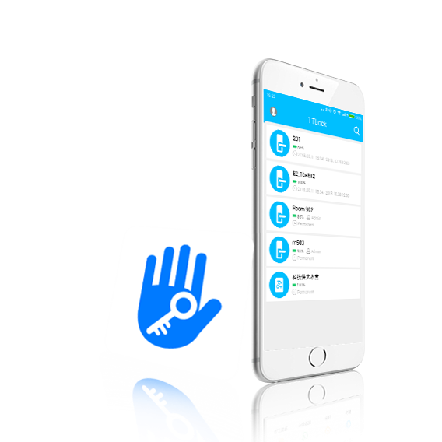
TT Lock

Slide 2
TT Lock function
Content
（Ⅰ）Introduction
（Ⅱ）Software installation
（Ⅲ）Main functions
3 key management
3.1 one-time passcode
3.2 key management
3.3 deadline warning
3.4 search lock record
4 passcode management
4.1 permanent passcode
4.2 time-limited passcode
4.3 one-time passcode
4.4 clear code
4.5 cyclic passcode
4.6 custom passcode
4.7 passcode sharing
4.8 passcode management
5 card management
6 fingerprint management
7 Bluetooth unlock
8 attendance management
8.1 attendance management
8.2 staff management
8.3 attendance statistics
8.4 attendance check
8.5 property settings
8.6 time settings
8.7 workday settings
8.8 holiday settings
9 system setting
9.1 key groups management
9.2 transfer admin rights
9.3 AI customer service
9.4 about the APP
10 gateway management
10.1 gateway adding
10.2 manual
1 registration and login
1.1 security question settings
1.2 login authentication
1.3 ways of identifying
1.4 login successful
2 key management
2.1 lock supporting
2.2 lock adding
2.3 lock upgrading
2.4 error diagnosis and
time calibration

Slide 3
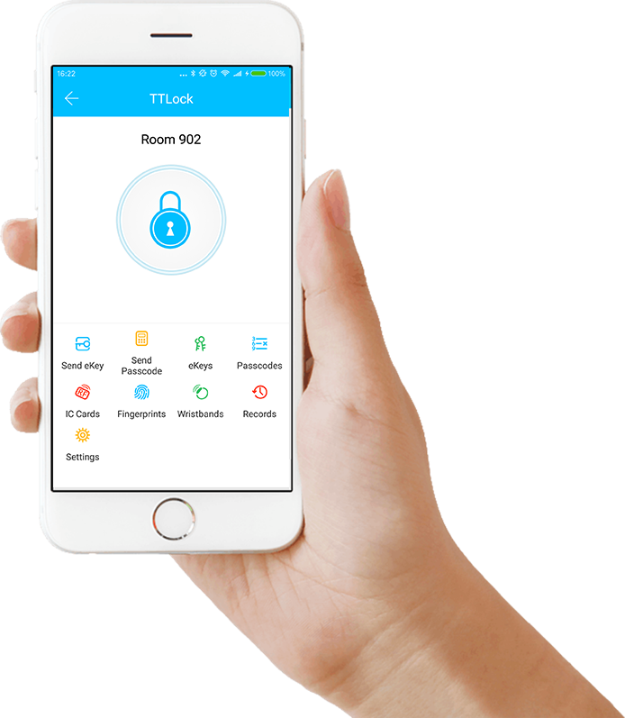
(Ⅰ)Introduction
TT lock function
Introduction
TT Lock App is a management software for smart lock . This APP can be used to manage various types of smart locks, including door locks, parking locks, safe locks, bicycle locks, and so on. The App and the lock communicate via Bluetooth BLE to unlock, lock, hardware upgrade, read operation record, etc. on the App. The Bluetooth key can also help open the door lock through the AI watch.
Currently, the App supports Chinese (Simplified and Traditional), English and Spanish. More languages will be supported in the future.

Slide 4
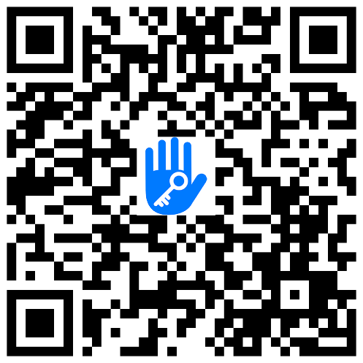
（Ⅱ） Software installation
TT lock function
Software installation
The software (iOS version) can be downloaded from the app store, and the Android version can be downloaded from the application store of Google play, Yingyongbao, Baidu, Ali, 360, Huawei, and Xiaomi.
Scan to download TT lock

Slide 5
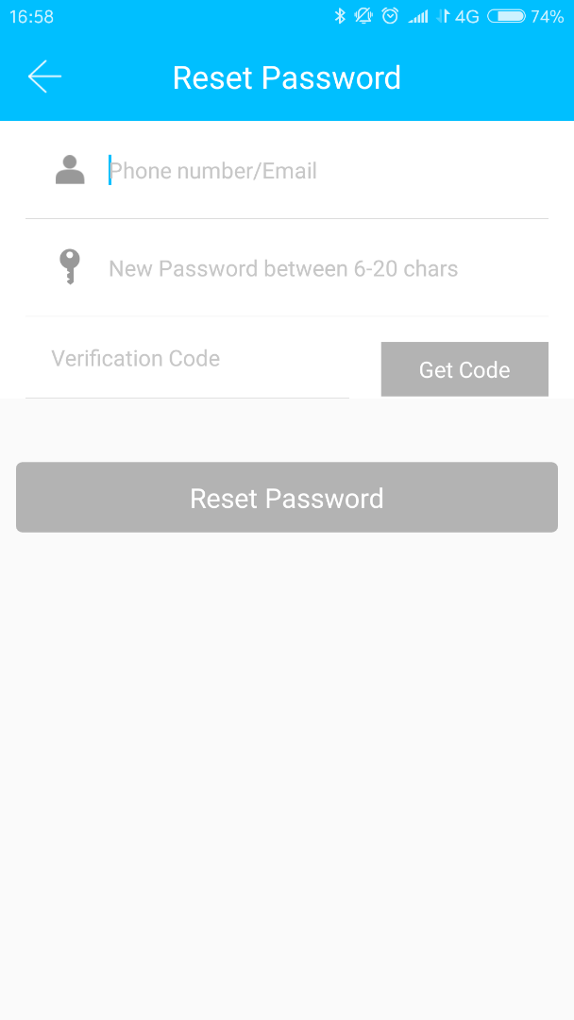
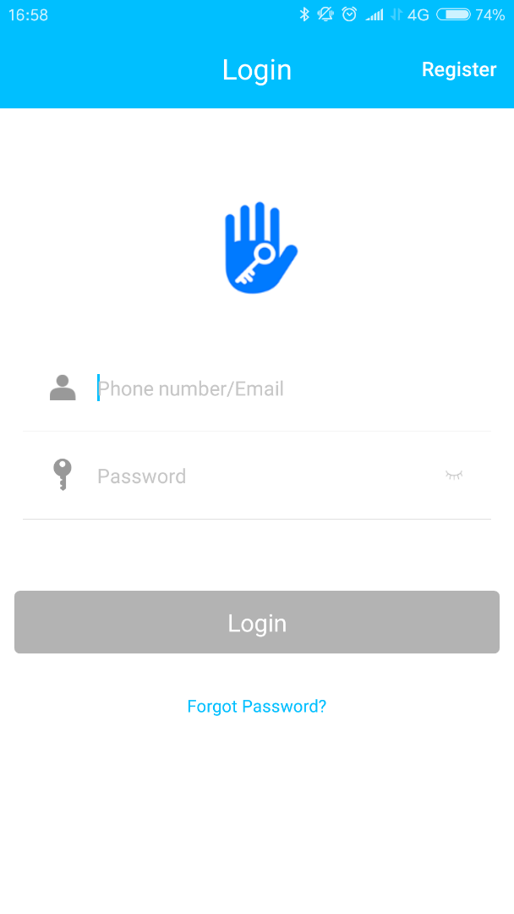
（Ⅲ）Main functions-registration and login
TT lock function
1. Registration and login
TT lock users can register the account by mobile phone and Email which currently support 200 countries and regions on the world. The verification code will be sent to user’s mobile phone or email, and the registration will be successful after the verification.

Slide 6
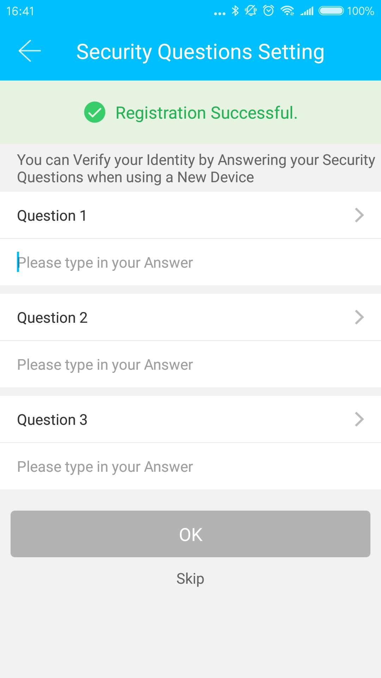
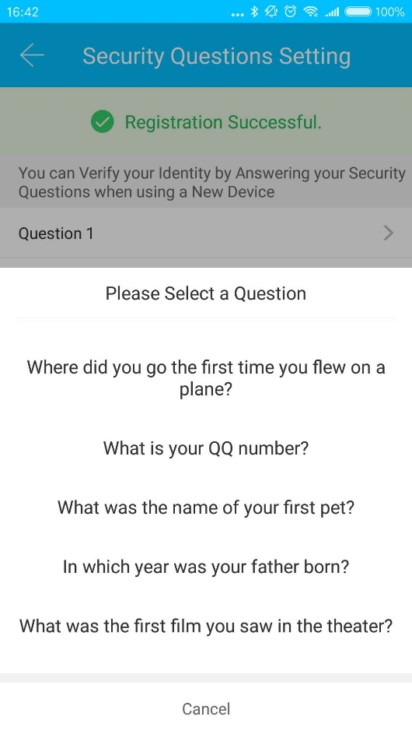
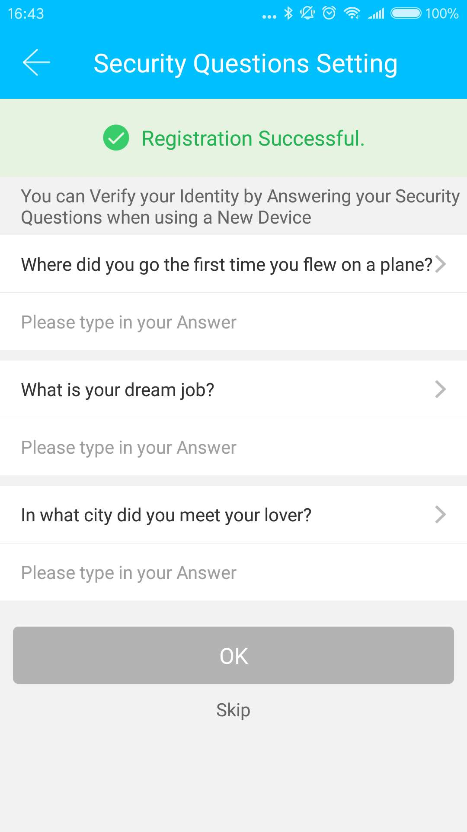
（Ⅲ）Main functions-registration and login
TT lock function
1.1 Security question settings
You will be taken to the security question settings page when registration is successful. When log in on a new device, the user can authenticate himself by answering the above questions.

Slide 7
（Ⅲ）Main functions-registration and login
TT lock function
1.2 Login authentication
Log in with your mobile phone number or email account on the login page. The mobile phone number is automatically recognized by the system and does not input the country code. If you have forgotten your password, you can go to the passward page to reset your password. When reset the password, you can receive a verification code from your mobile phone and email address.

Slide 8
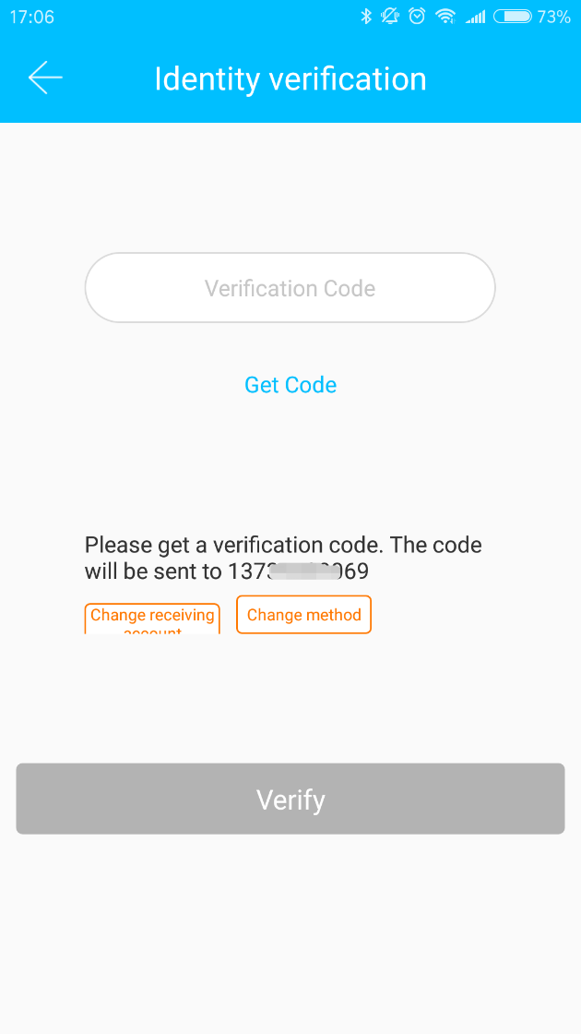
（ Ⅲ ）Main functions-registration and login
TT lock function
When the account is logged in on the new mobile phone, it needs to be verified. When it is passed, you can log in on the new mobile phone. All the data can be viewed and used on the new mobile phone.

Slide 9
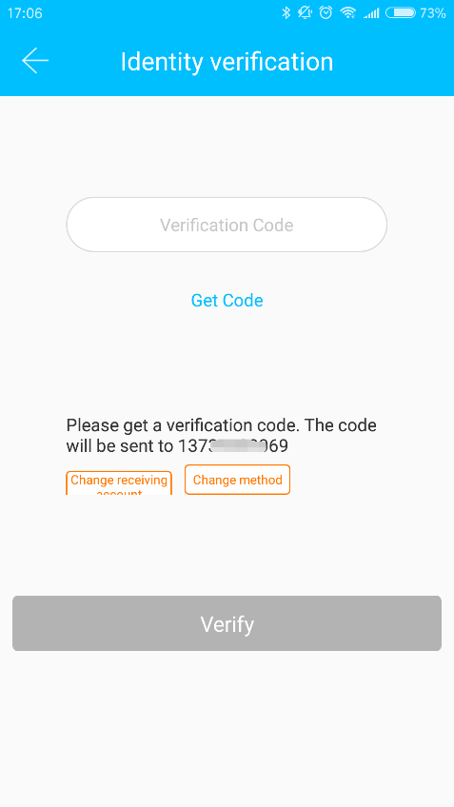
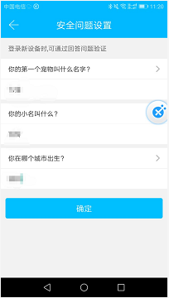
（ Ⅲ ）Main functions-registration and login
TT lock function
verify with verification code as shown：
verify by answering questions as shown ：
1.3 Verification mode
There are two ways of security verification. One is the way to get the verification code via the account number, and the other is the way to answer the question. If the current account is set the "answer the question" verification, then when the new device is logged in, there will be an "answer question verification" option.

Slide 10
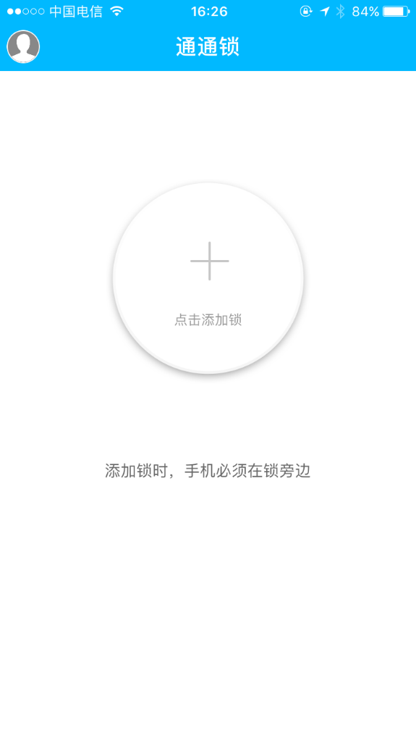
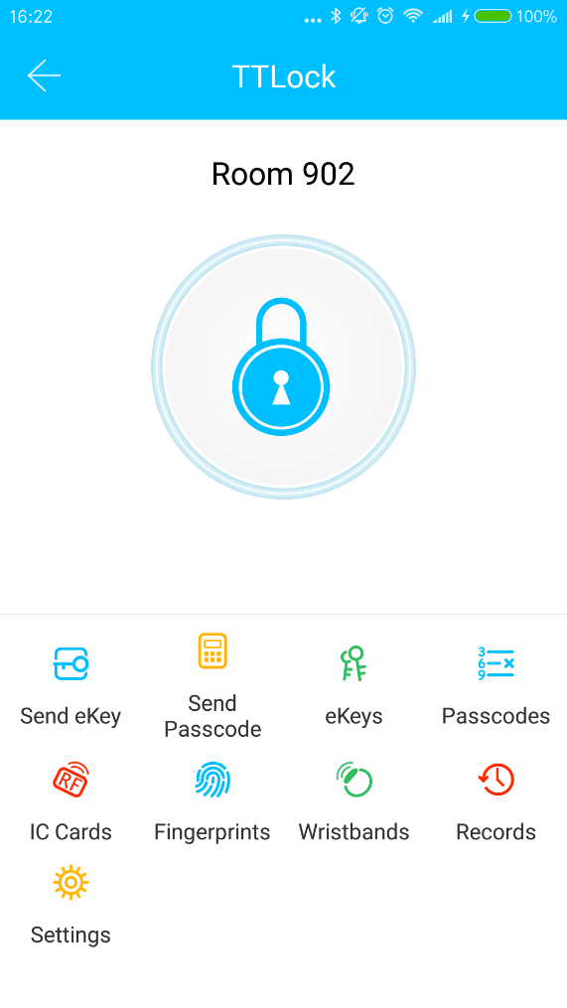
（ Ⅲ ）Main functions-registration and login
TT lock function
1.4 Login successful
The first time you use the lock lock app, if there is no lock or key data in the account, the home page will display the button to add the lock. If there is already a lock or key in the account, the lock information will be displayed.
no lock adding
the account with lock

Slide 11
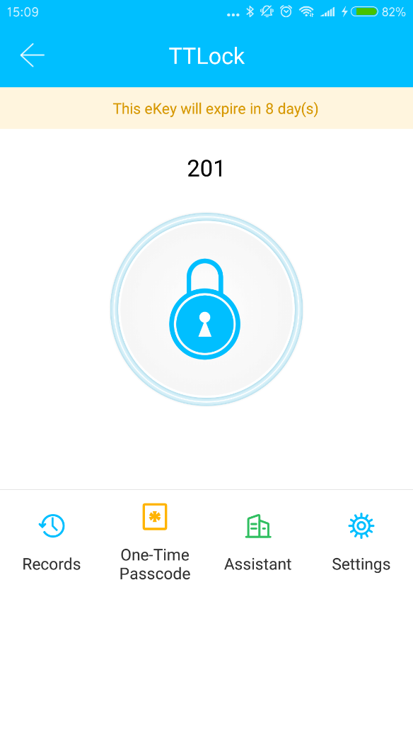
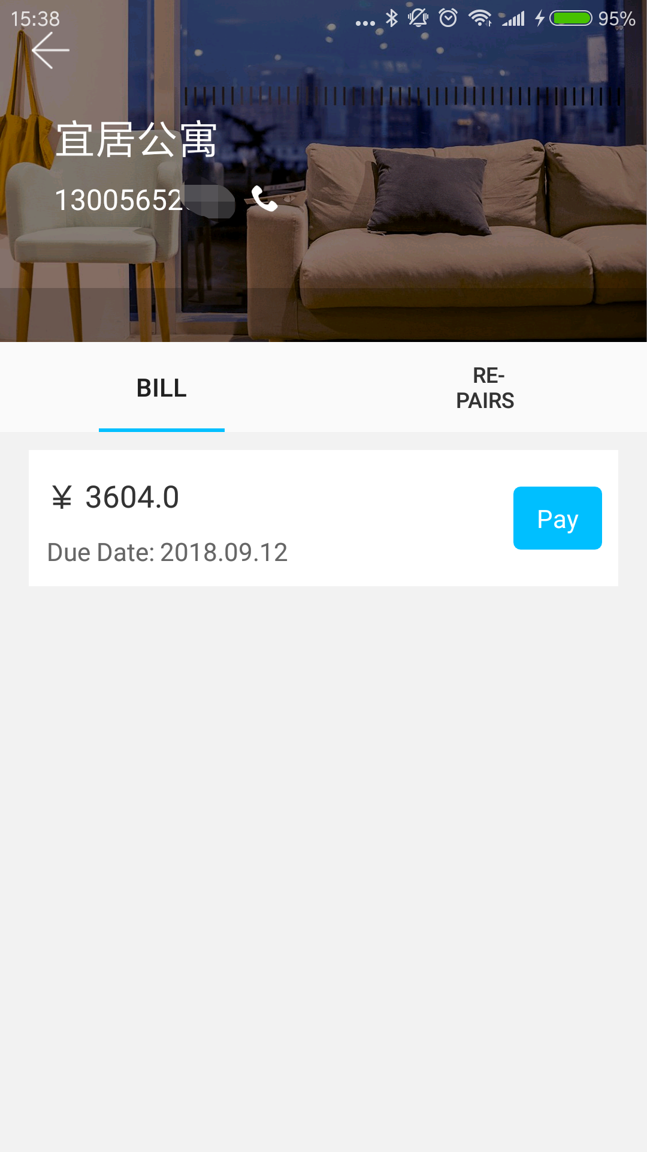
（ Ⅲ ）Main functions-registration and login
TT lock function
Apartment assistant
The apartment assistant module can be seen in the lock app only when the key comes from the apartment.
In the apartment assistant module, you can pay rent and repair. The landlord collects the rent from the Room Master APP and sends the rent bill to the tenant. According to actual usage, the bill includes rent, water and electricity, gas, property, broadband, etc.

Slide 12
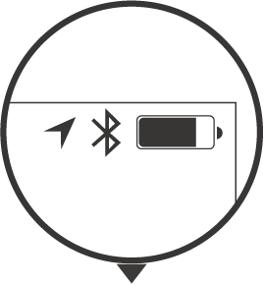
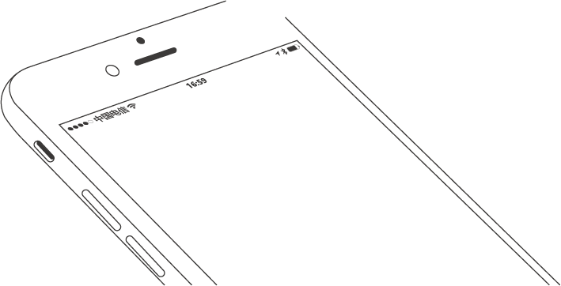
（ Ⅲ ）Main functions-lock management
TT lock function
2. Lock management
The lock must be added on the app before it can be used. The addition of a lock refers to the initialization of the lock by communicating with the lock via Bluetooth. Please stand beside the lock. Once the lock is added successful, you can manage the lock with the app including sending a key, sending a password, and so on.
When the lock is added, the adder becomes the administrator of the lock. At the same time, the lock cannot enter the setup mode by touching the keyboard. This lock can only be re-added after the current administrator has deleted the lock. The operation of deleting the lock needs to be done by Bluetooth beside the lock.

Slide 13
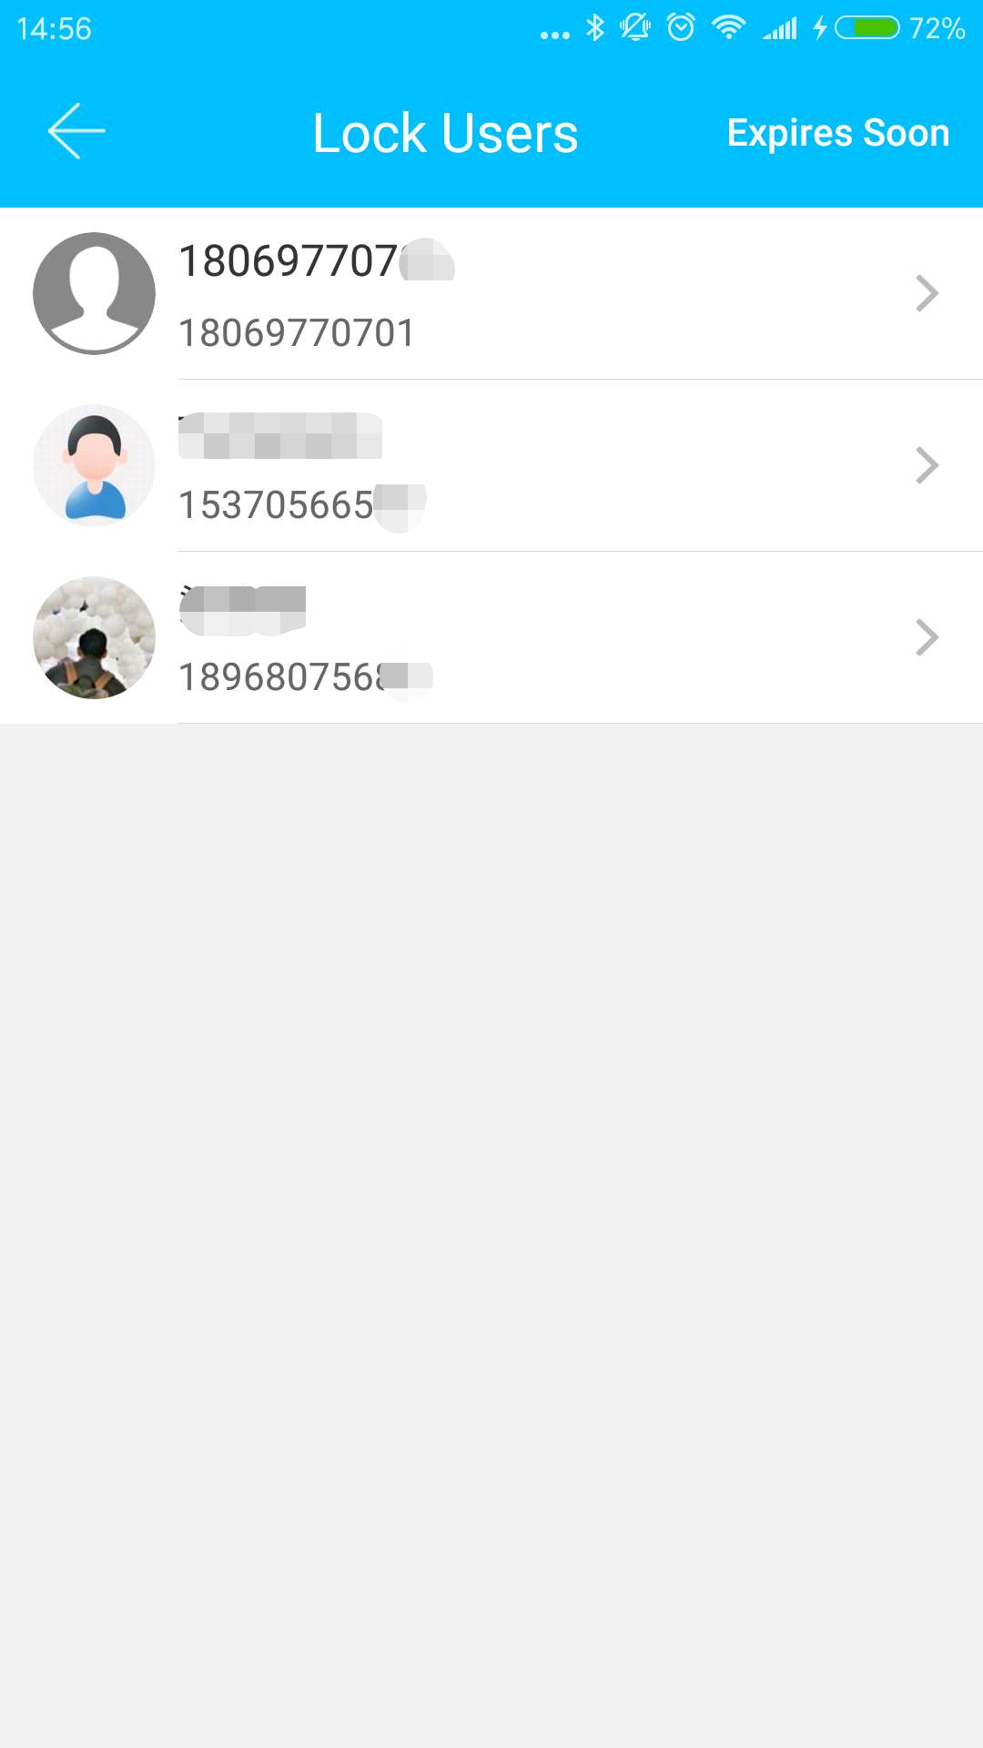
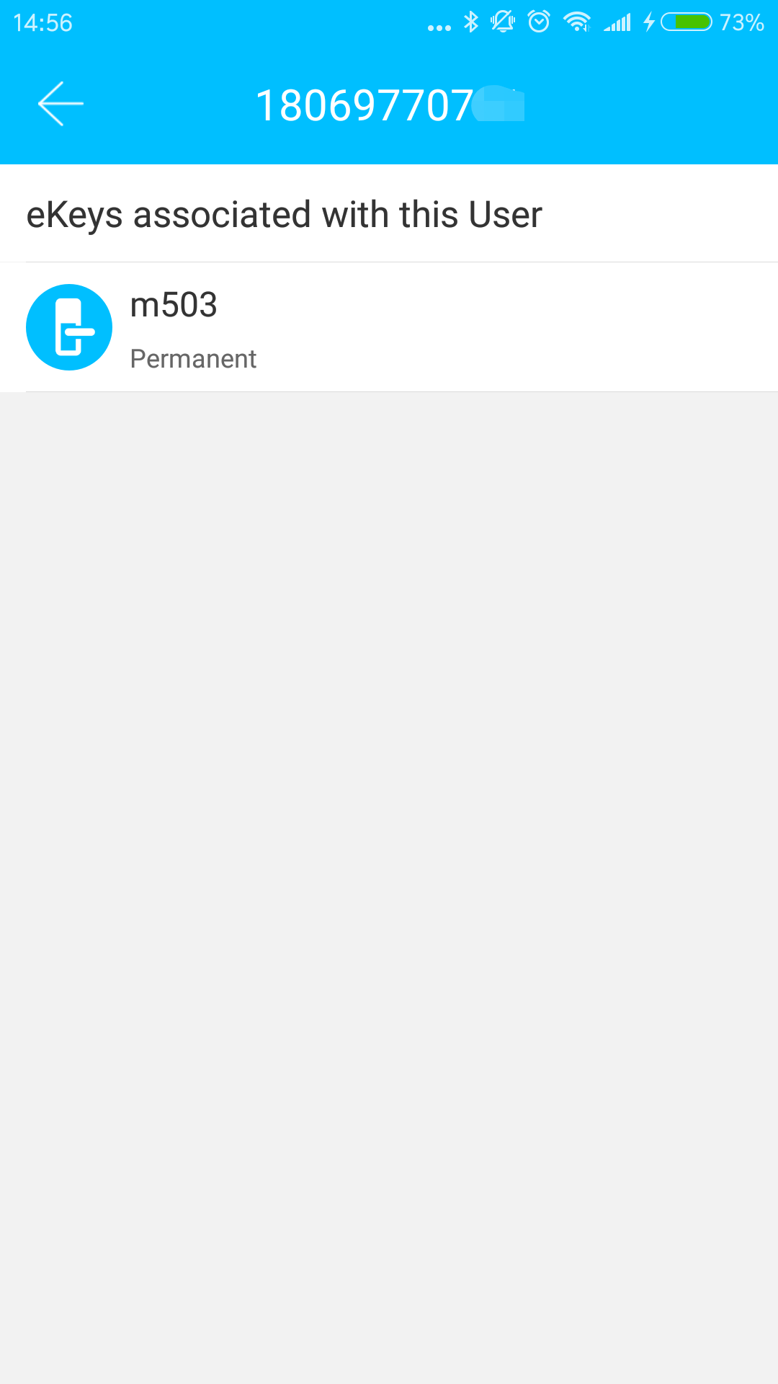
（ Ⅲ ）Main functions-lock management
TT lock function
User management
You can see the customer's name and phone number in the lock user list. Click on the customer you need, then it will display the door lock information and room number.

Slide 14
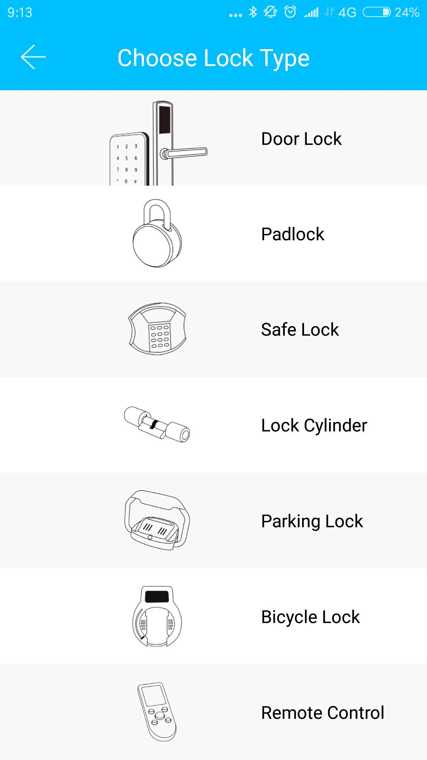
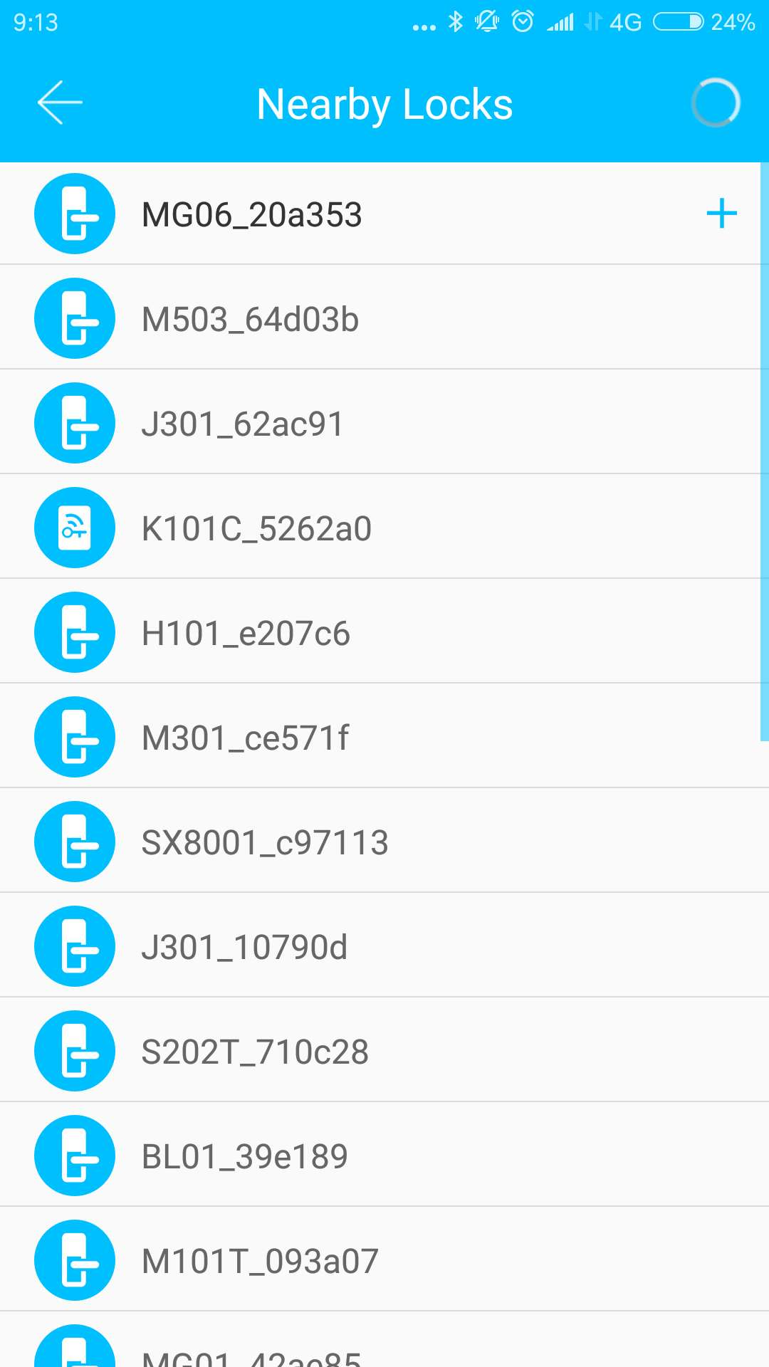
（ Ⅲ ）Main functions-lock management
TT lock function
2.1 Lock supporting
The Kejixia App supports multiple types of lock, including door locks, padlocks, safe locks, smart lock cylinders, parking locks, and bicycle locks. When adding a device, you must firstly select the lock type. The lock needs to be added to the app after entering the setting mode. A lock that has not been added will enter the setting mode as long as the lock keyboard is touched. The lock that has been added needs to be deleted on the App first.

Slide 15
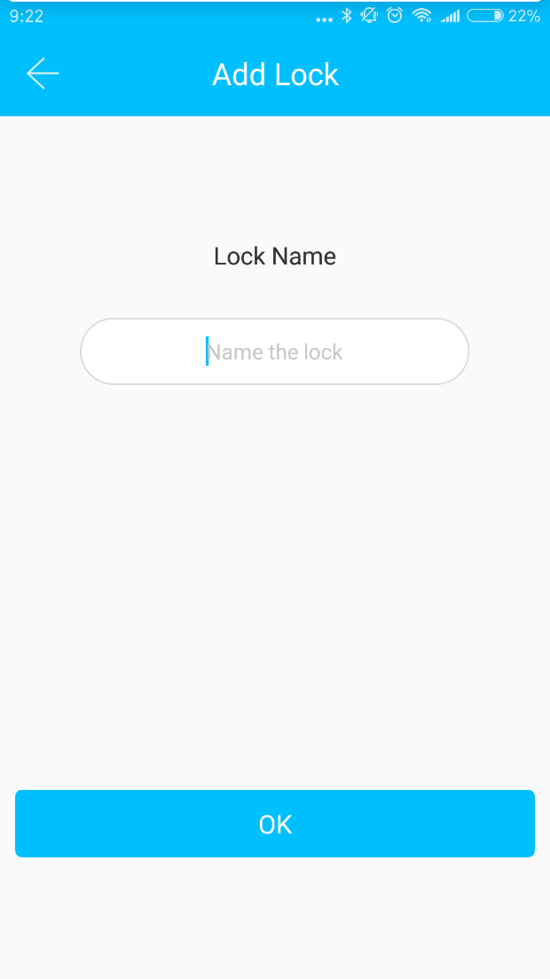
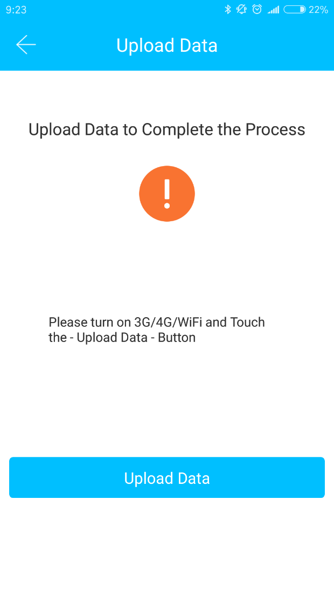
（ Ⅲ ） Main functions-lock management
TT lock function
2.2 Lock adding
The initialization data of the lock needs to be uploaded to the network. The data needs to be uploaded when the network is available to complete the entire whole adding process.

Slide 16
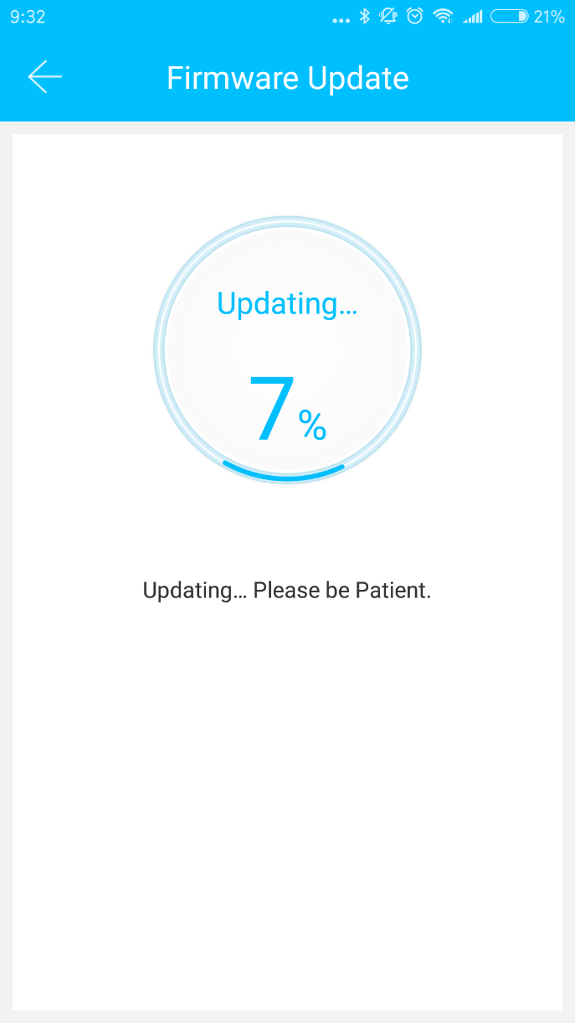
（ Ⅲ ） Main functions-lock management
TT lock function
2.3 Lock upgrade
User can upgrade the lock firmware on the TT lock APP. The upgrade needs to be done via Bluetooth next to the lock. When the upgrade is successful, the original key, password, IC card, and fingerprint can continue to be used.

Slide 17
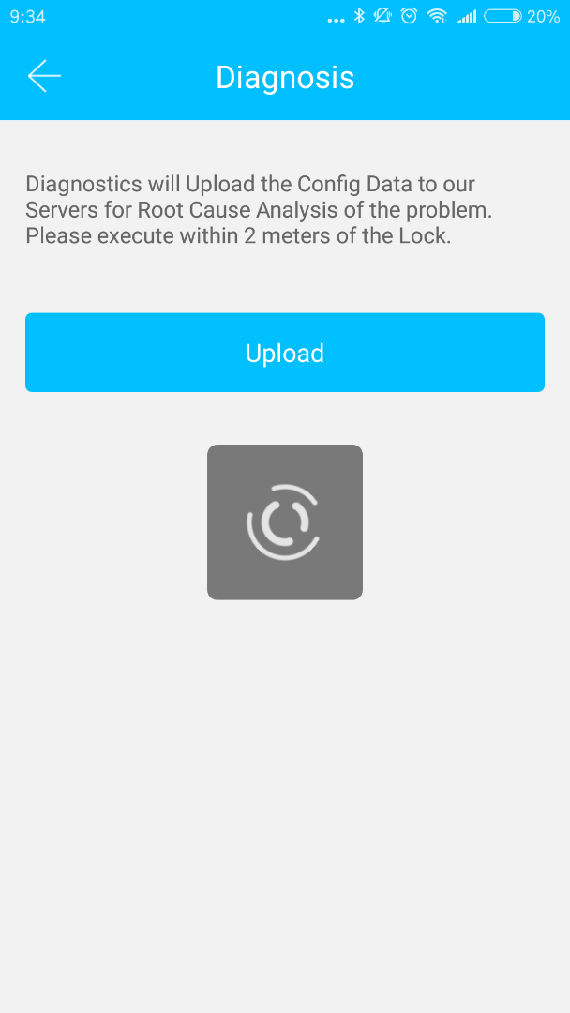
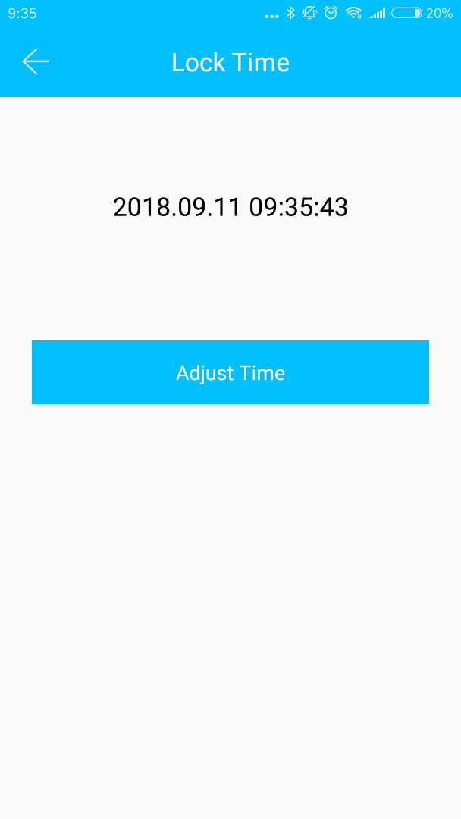
（ Ⅲ ） Main functions-lock management
TT lock function
2.4 Error diagnosis and time calibration
Error diagnosis aims to help analyse the system problems. It needs to be done via Bluetooth beside the lock.
If there is a gateway, the clock will be calibrated firstly through the gateway. If there is no gateway, it needs to be calibrated by the mobile phone Bluetooth.

Slide 18
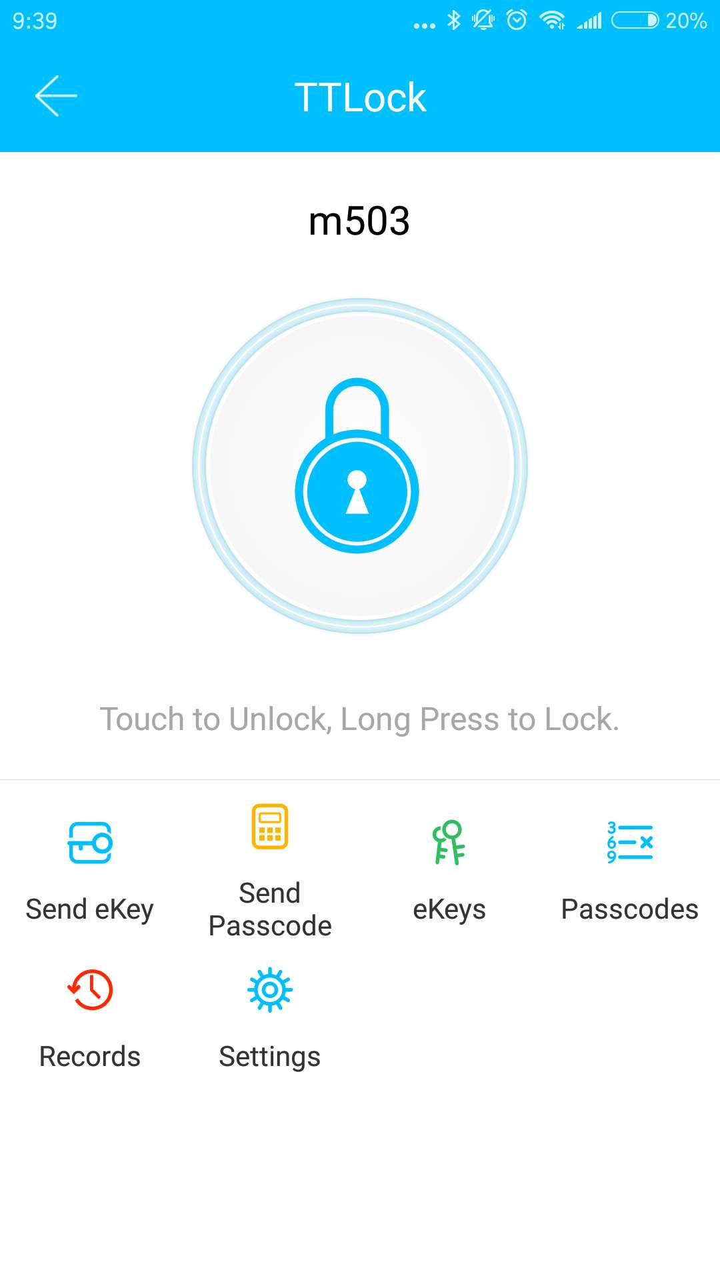
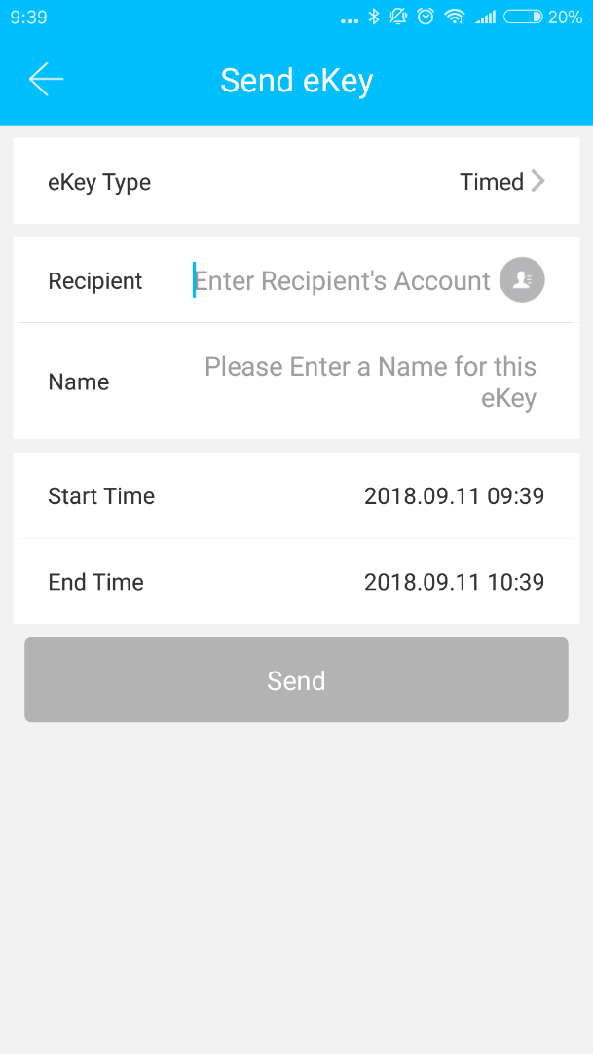
（ Ⅲ ） Main functions-ekey management
TT lock function
3. Ekey management
After the administrator successfully adds the lock, he owns the highest administrative rights to the lock. He can send keys to others. Meanwhile he can increase the key management that is about to expire.

Slide 19
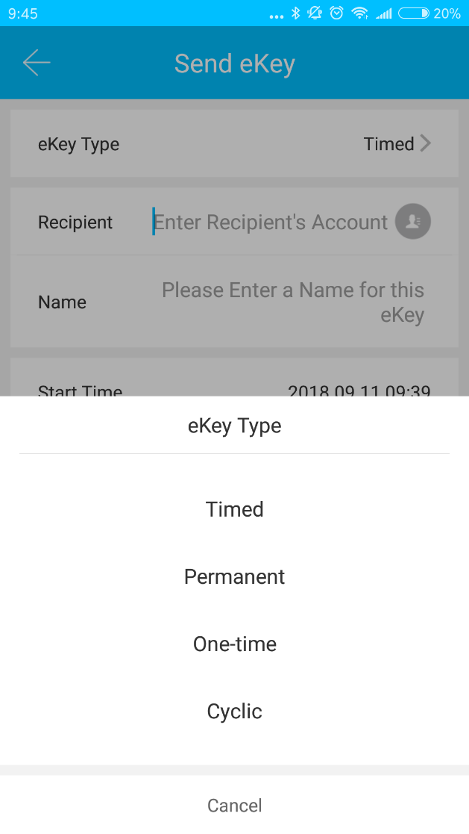
（ Ⅲ ）Main functions-ekey management
TT lock function
Click the type of lock it will show the time-limited ekey, one-time ekey and permanent ekey.
Time-limited ekey: The ekey is valid for the specified time.
Permanent ekey: The ekey can be used permanently.
One-time ekey: the ekey will be automatically deleted once it has been used.

Slide 20
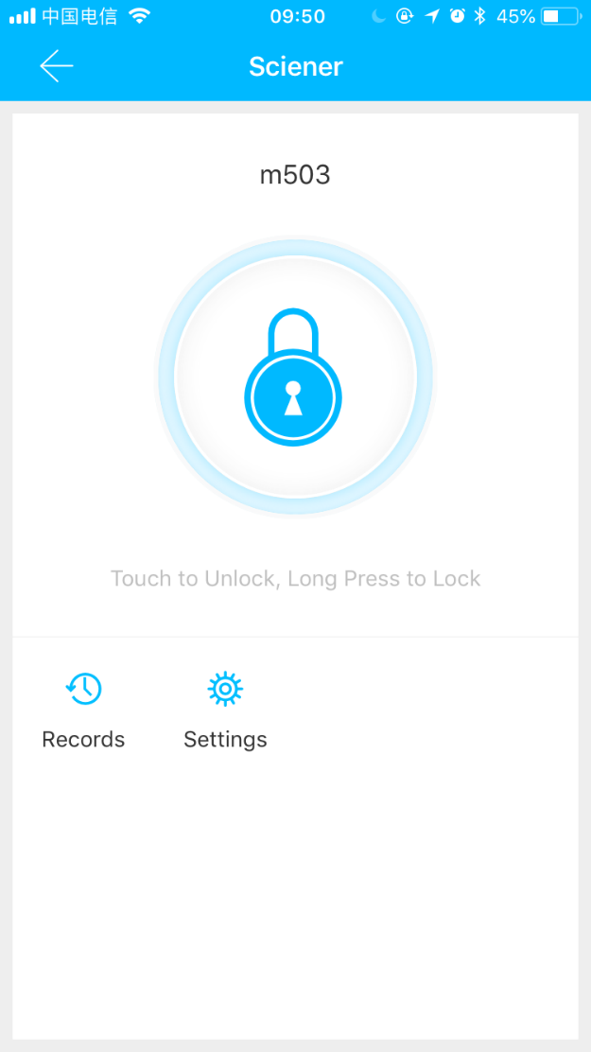
（ Ⅲ ） Main functions-ekey management
TT lock function
as shown：
3.1 One-time passcode
The ekey sent from the Room Master APP has the function of obtaining a one-time passcode.

Slide 21
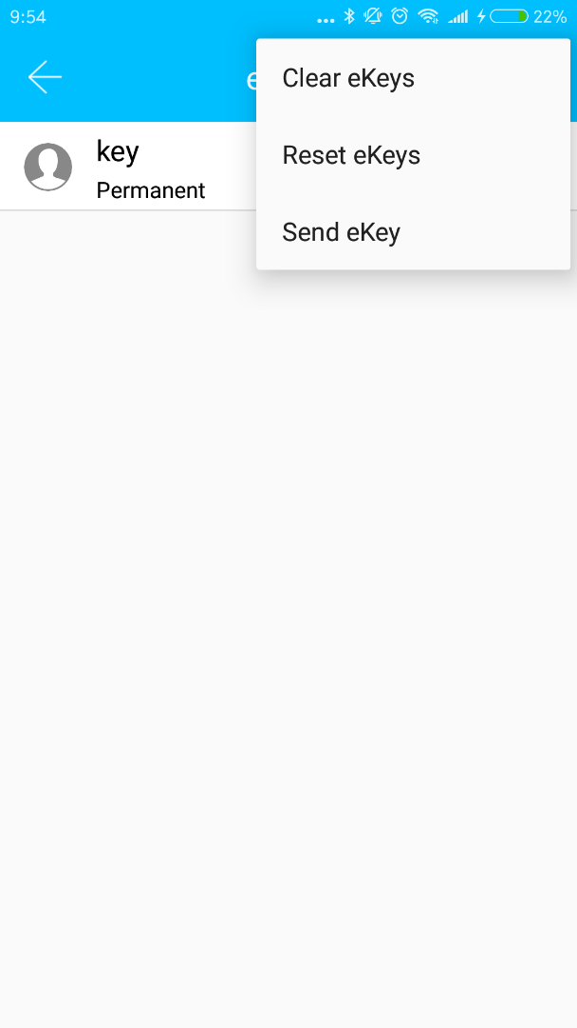
（ Ⅲ ） Main functions-ekey management
TT lock function
3.2 Ekey management
The manager can delete ekey, reset ekey, send and adjust the ekey, meanwhile he can search the lock record.

Slide 22
（ Ⅲ ） Main functions-ekey management
TT lock function
3.3 Deadline warning
System will show two colors for deadline warning. The yellow means close to expiring and the red means it has expired.

Slide 23
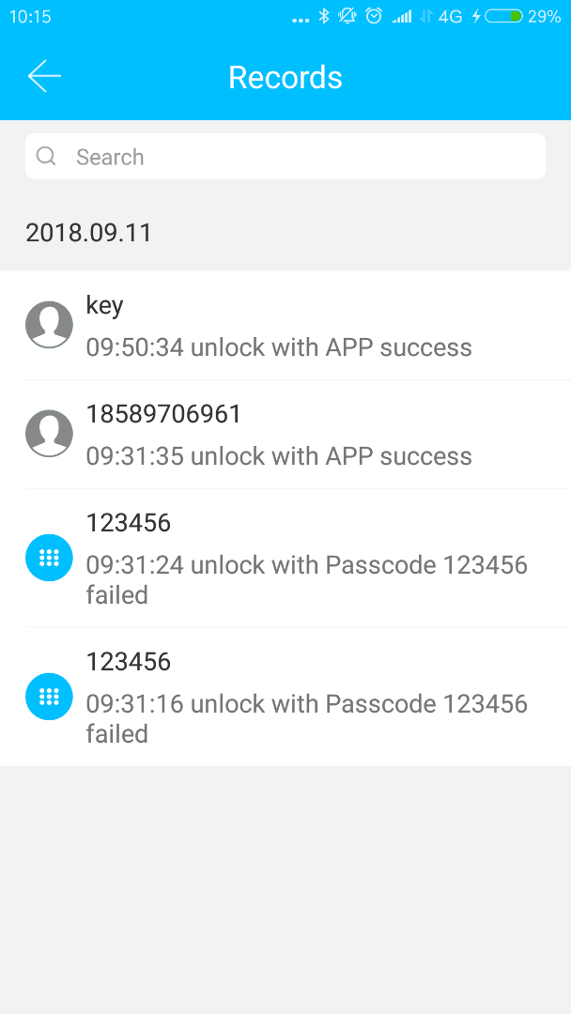
（ Ⅲ ）Main functions-ekey management
TT lock function
3.4 Search lock record
The administrator can query the unlock records of each key.

Slide 24
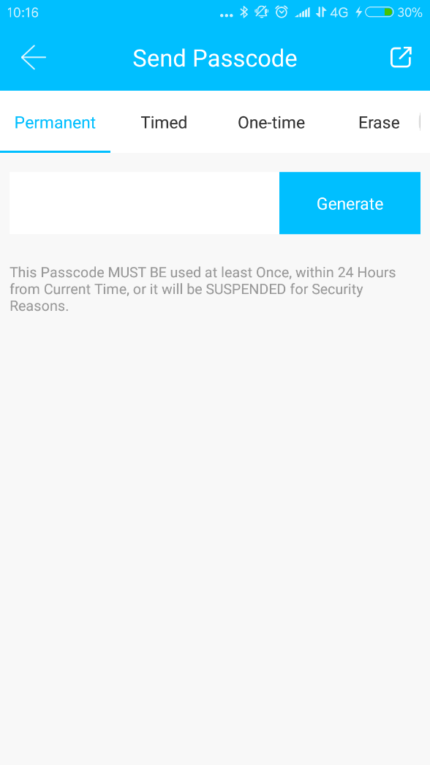
（ Ⅲ ） Main functions-types of passcode
TT lock function
4. Type of passcode
After inputting the passcode on the keyboard of the lock, press the unlock button to unlock. Passcodes are classified into permanent, time-limited, one-time, empty, loop, custom, etc.
4.1 Permanent passcode
The permanent passcode must be used within 24 hours after it is generated, otherwise it will automatically expire.

Slide 25
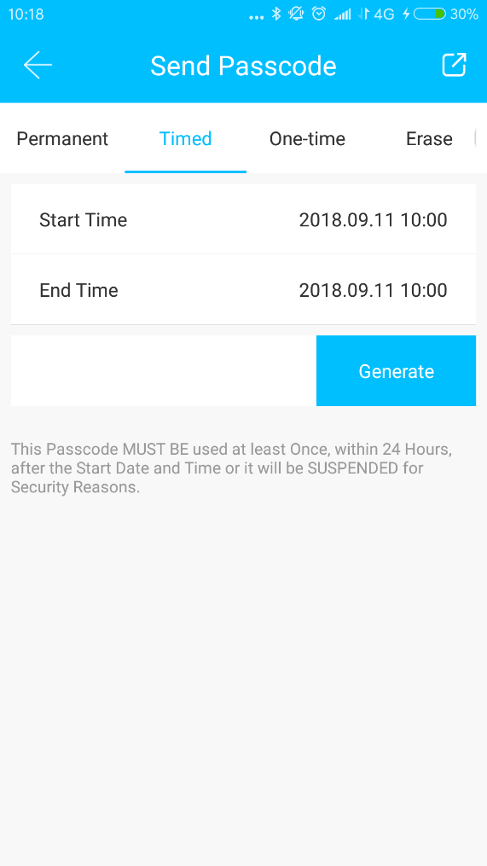
（ Ⅲ ） Main functions-passcode management
TT lock function
4.2 Time-limited passcode
The time-limited passcode can own an expiration date, which is a minimum of one hour and a maximum of three years. If the validity period is within one year, the time can be accurate to the hour; if the validity period is more than one year, the accuracy is month. When the time-limited passcode is valid, it should be used within 24 hours, otherwise it will automatically expire.
After inputting the passcode, please press the lock button or # on the right corner to lock the door.
The way to change the passcode: input the original passcode to unlock, then input “10 # original passcode # new passcode (between 4 numbers and 6numbers) # input new passcode again # ”.

Slide 26
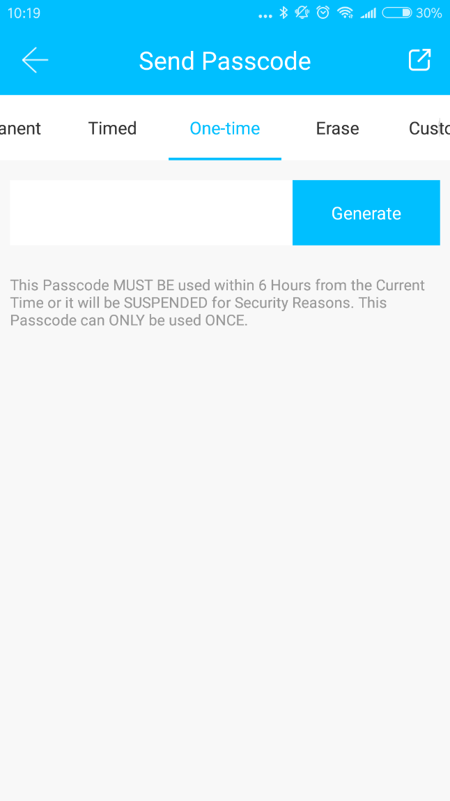
（ Ⅲ ） Main functions-types of passcode
TT lock function
4.3 One-time passcode
One-time passcode can only be used for one time, and which is available for 6 hours.

Slide 27
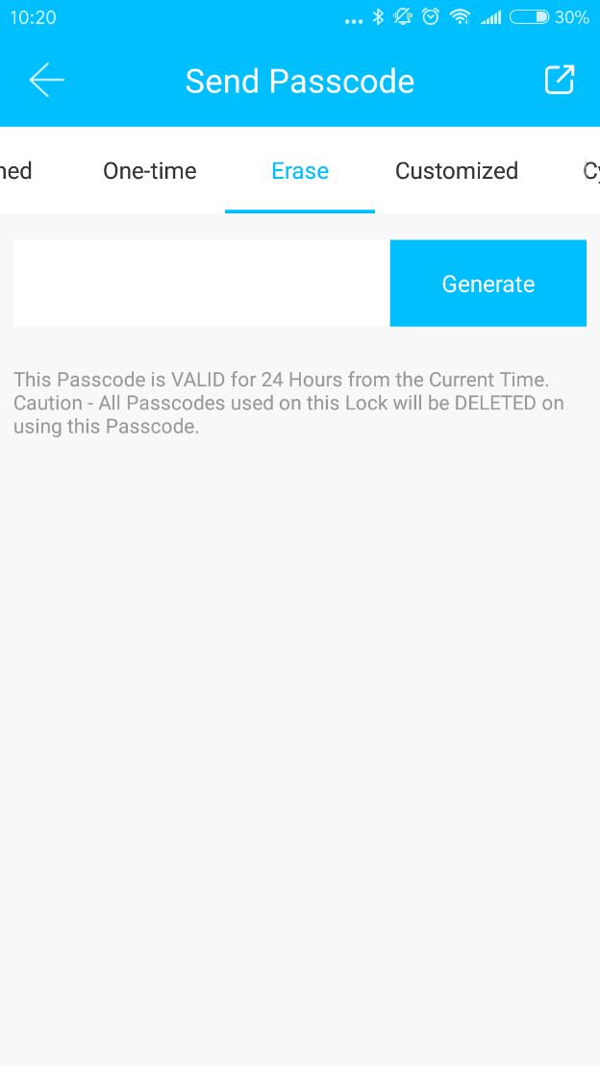
（ Ⅲ ） Main functions-types of passcode
TT lock function
4.4 Clear code
Clear code is used to delete all the passcodes the lock has set, and which is available for 24 hours.

Slide 28
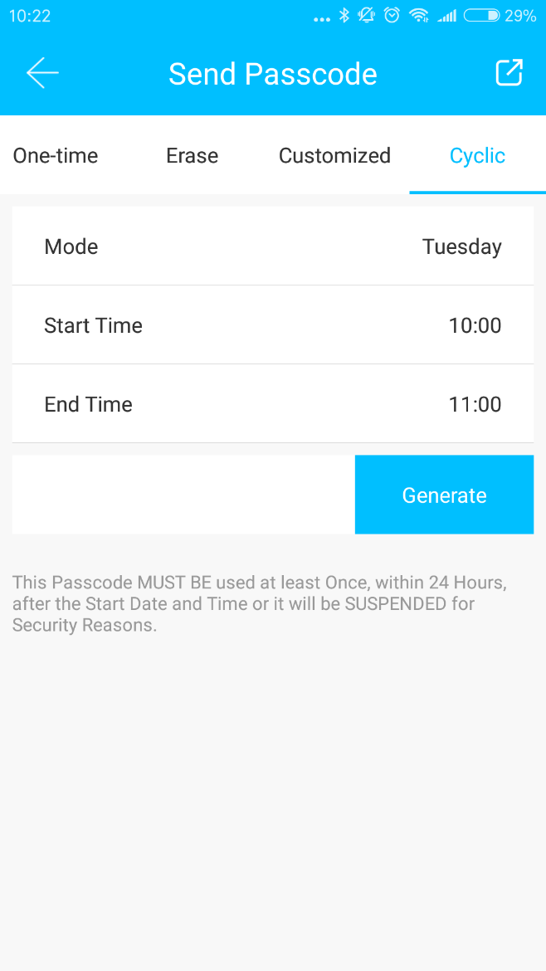
（ Ⅲ ） Main functions-passcode management
TT lock function
4.5 Cyclic passcode
The cyclic password can be reused within a specified time period, including daily type, weekday type, weekend type, and more.

Slide 29
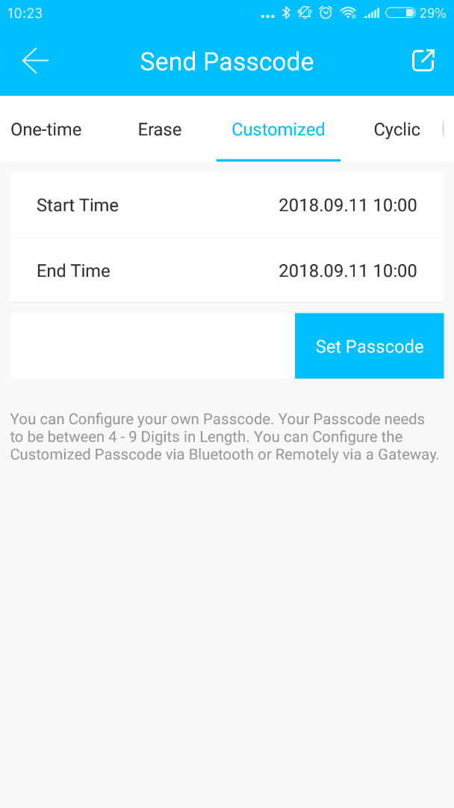
（ Ⅲ ） Main functions-passcode management
TT lock function
4.6 Custom passcode
User can set any passcodes and validity period he wants.

Slide 30
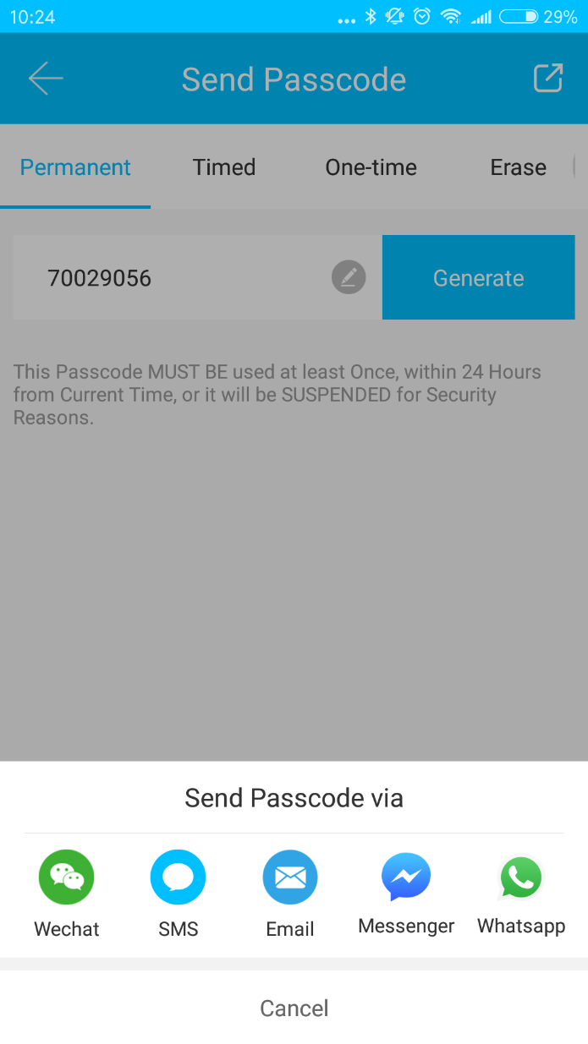
（ Ⅲ ） Main functions-passcode management
TT lock function
4.7 Passcode sharing
The system add new communication ways of Facebook Messenger and Whatsapp to help users share the passcode.

Slide 31
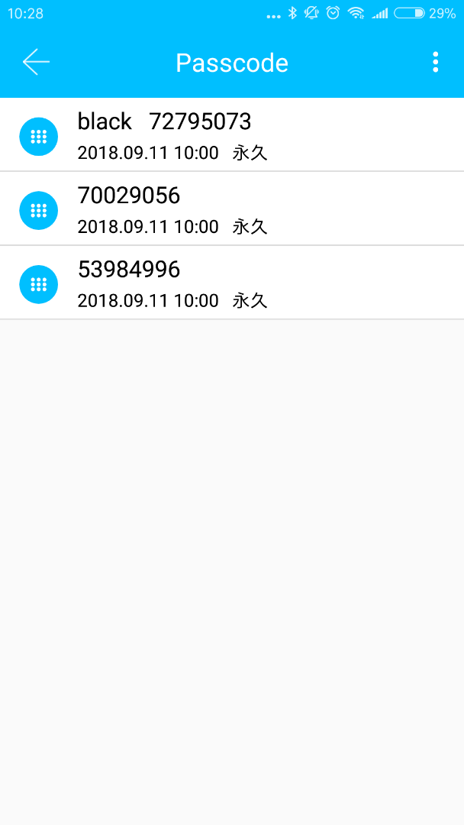
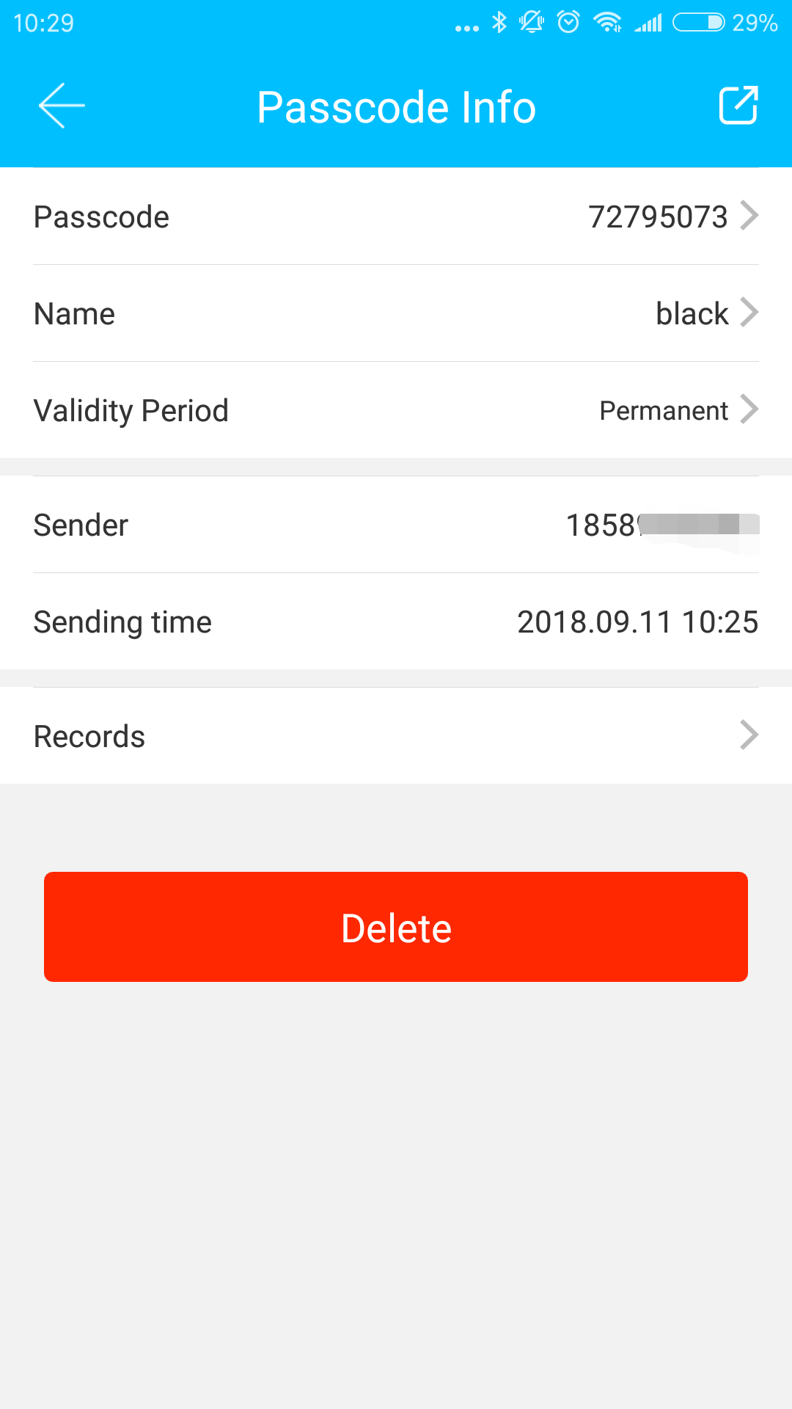
（ Ⅲ ） Main functions-passcode management
TT lock function
4.8 Passcode view and management
All generated passcodes can be viewed and managed in the password management module. This includes the right of changing the password, deleting the password, resetting the password, and unlocking the password.

Slide 32
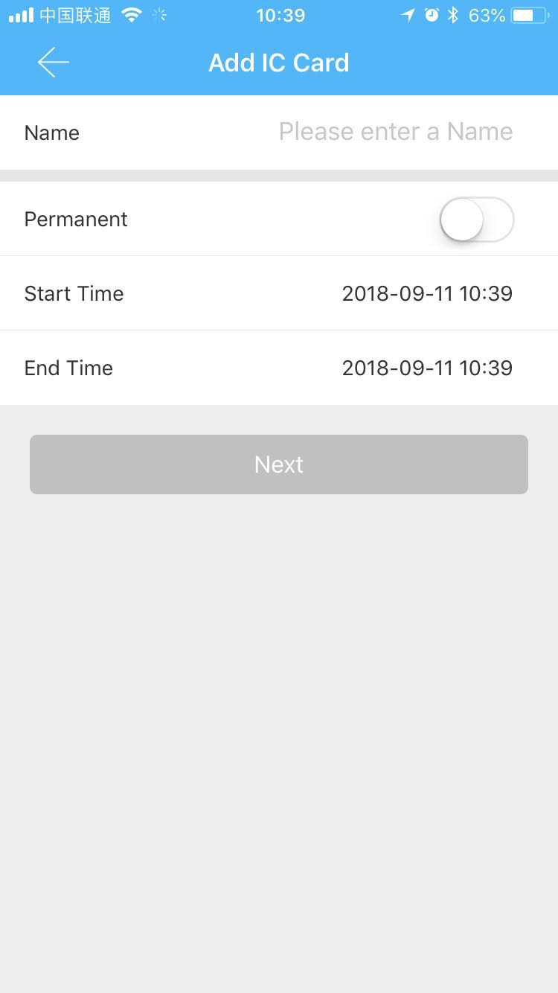
（ Ⅲ ）Main functions-card management
TT lock function
5. Card management
You need to add the IC card first. The whole process needs to be done via the app beside the lock. The validity period of the IC card can be set, either permanent or time-limited.

Slide 33
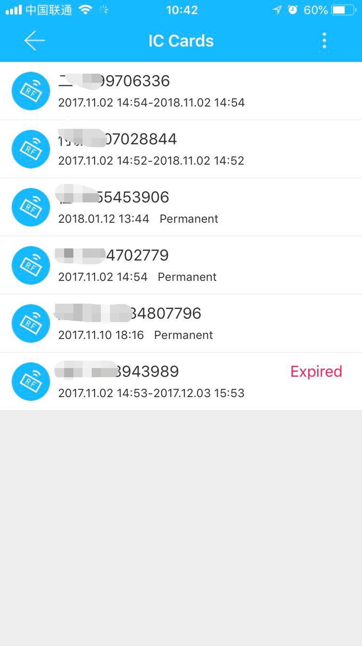
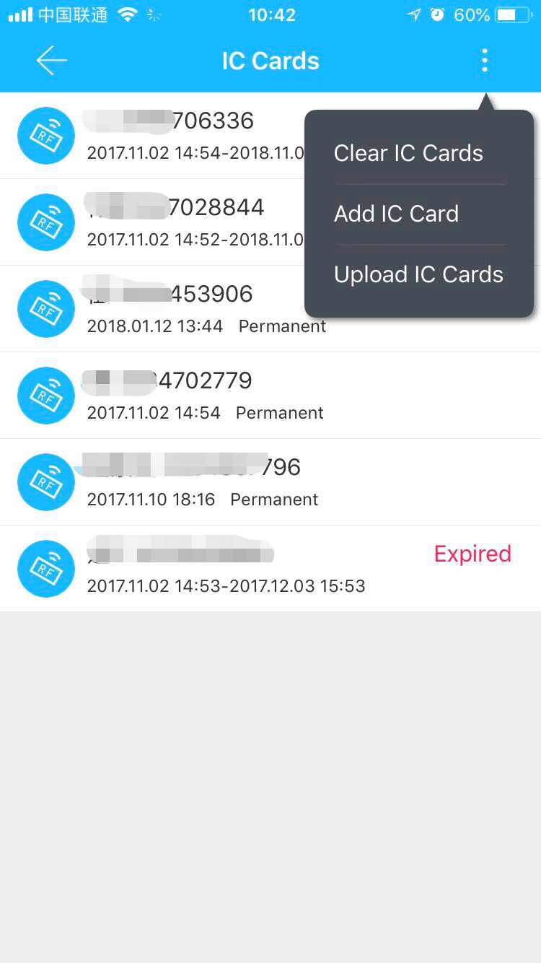
（ Ⅲ ） Main functions-card management
TT lock function
5.1 Card view and management
All IC cards can be queried and managed through the IC card management module.
The remote card issuance function is displayed in the case of a gateway. If there is no gateway, the item is hidden.

Slide 34
（ Ⅲ ） Main functions-fingerprint management
TT lock function
6. Fingerprint management
Fingerprint management is similar to IC card management. After adding a fingerprint, you can use the fingerprint to unlock the door.

Slide 35
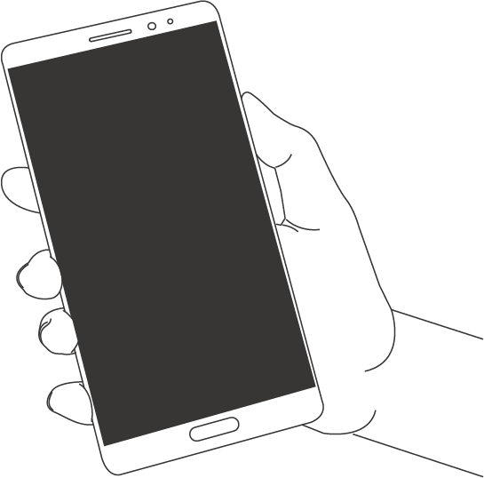
（ Ⅲ ） Main functions-unlock via Bluetooth
TT lock function
7. Unlock via Bluetooth
User can lock the door via Bluetooth and can also send the Bluetooth ekey to anyone.
Two ways of unlocking the door: a. press the unlock button on the APP; b, touch and light the lock panel.

Slide 36
（ Ⅲ ） Main functions-unlock via Bluetooth
TT lock function
Use APP to unlock
Click the round button at the top of the page to unlock the door. Since the Bluetooth signal has a certain coverage, please use the APP within the certain area.
Touch to unlock
You can Open the app and touch the keyboard to unlock the door.
Click the small button to open the door remotely when you have installed the gateway.

Slide 37
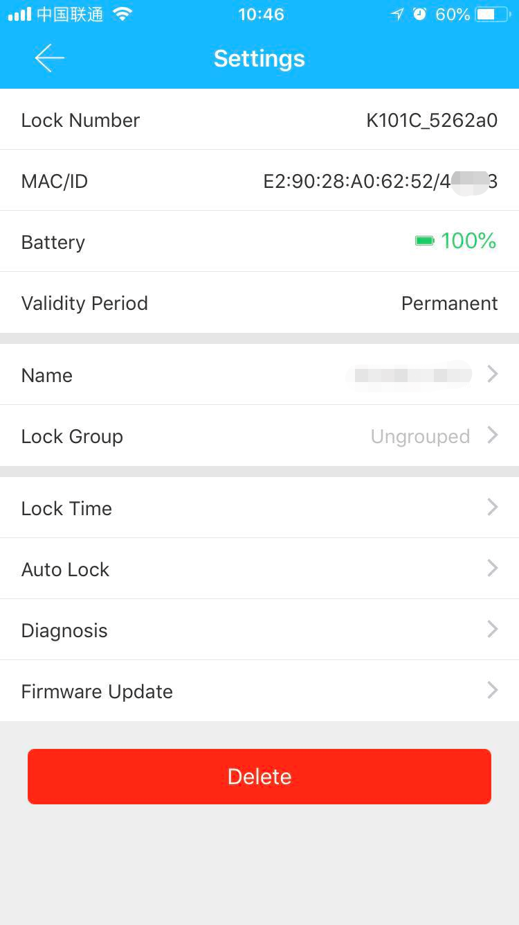
（ Ⅲ ） Main functions-attendance management
TT lock function
8. Attendance management
One product of Kejixia is access control, which can be used for company attendance management. The app contains functions of employee management, attendance statistics and so on.
All door locks have attendance function. You can turned the lock on or off in the lock setting.

Slide 38
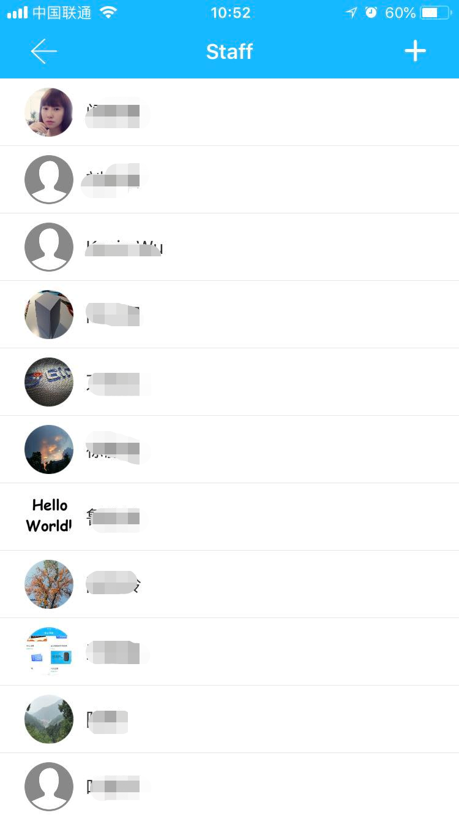
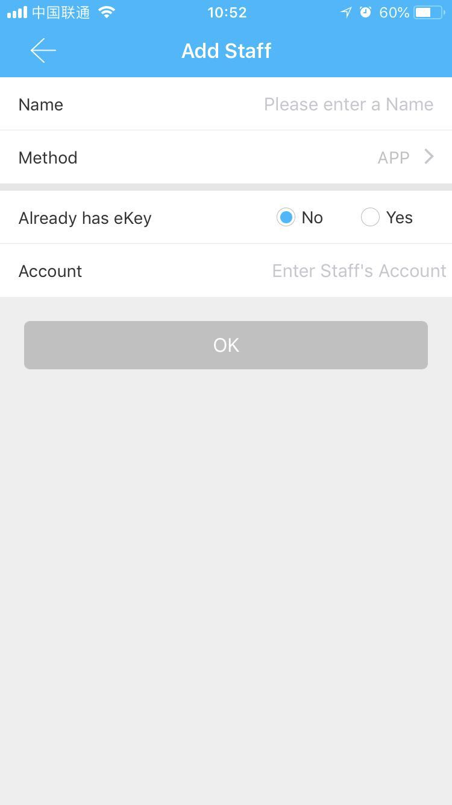
（ Ⅲ ） Main functions-attendance management
TT lock function
8.1 Staff management
Administrator can view and management the staff information in the staff management module.

Slide 39
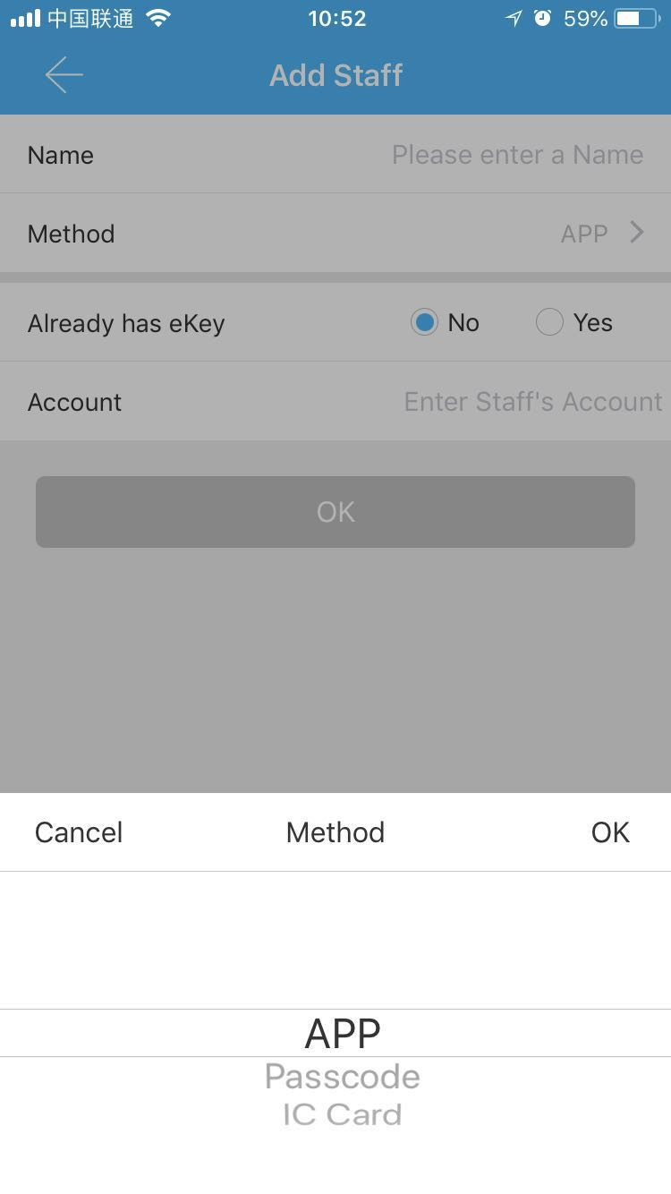
（ Ⅲ ） Main functions-attendance management
TT lock function
8.2 Attendance method
It supports staff attendance in three ways, including App, password, and IC card.

Slide 40
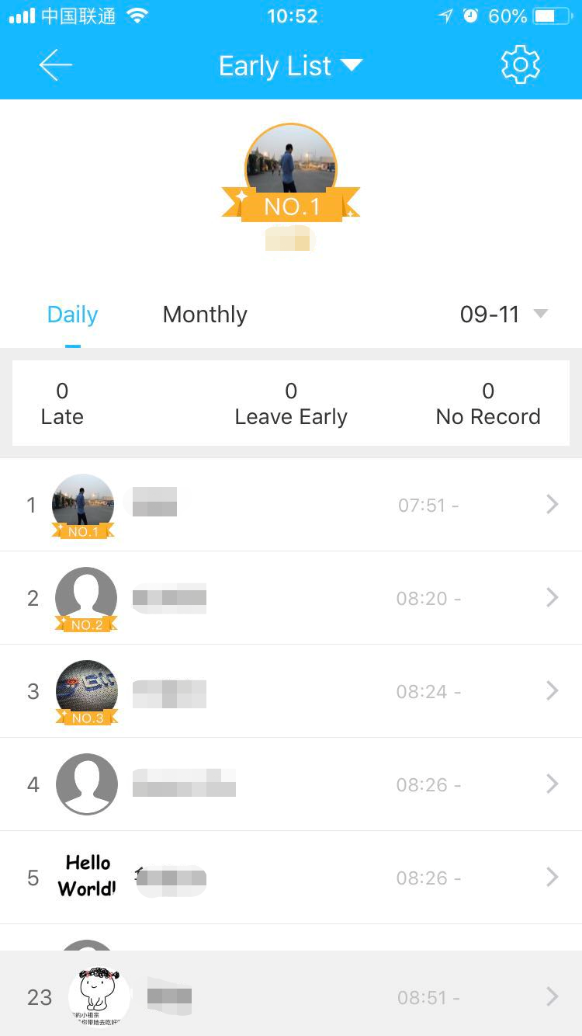
（ Ⅲ ） Main functions-attendance management
TT lock function
8.3 Attendance statistic
In this module, you can check the attendance of all employees on a certain day, according to the time of arrival at the company. Late arrivals, early departures, and unchecked cards are identified in three different colors.

Slide 41
（ Ⅲ ） Main functions-attendance management
TT lock function
8.4 Attendance check
Swipe from left to right to view the staff attendance on different months.

Slide 42
（ Ⅲ ） Main functions-attendance management
TT lock function
8.5 Property settings
In this module, you can set the company name, departments, working hours, working days, and holidays.

Slide 43
（ Ⅲ ） Main functions-attendance management
TT lock function
8.6 Time settings
The work time settings can judge if you are late or early to leave.

Slide 44
（ Ⅲ ） Main functions-attendance management
TT lock function
8.7 Workday settings
You can set certain workdays you want in this module.

Slide 45
（ Ⅲ ） Main functions-attendance management
TT lock function
8.8 Holiday settings
You can set holidays and workdays according to your need.

Slide 46
（ Ⅲ ） Main functions-system settings
TT lock function
9. System settings
In the system settings, it includes touch unlock switch, group management, gateway management, security settings, reminder, transfer smart lock and so on.
Touch unlock setting determines whether you can open the door by touching the lock.

Slide 47
（ Ⅲ ） Main functions-system settings
TT lock function
9.1 Key groups management
In the case of a large number of keys, you can use group management module.

Slide 48
（ Ⅲ ） Main functions-system settings
TT lock function
9.2 Transfer admin rights
The administrator can transfer the lock to other users or to the apartment (Room Master user). Only the account that manages the lock has the right to transfer the lock.

Slide 49
（ Ⅲ ） Main functions-system settings
TT lock function
After inputting the account, you will receive a verification code. Filling in the correct number, you will transfer successfully.
The account of the apartment transfer receive must be the administrator account.

Slide 50
（ Ⅲ ）Main functions-customer service
TT lock function
9.3 AI customer service
The user can consult and give feedback through the AI customer service.

Slide 51
（ Ⅲ ） Main functions-system settings
TT lock function
9.4 About the APP
In the About moduel, you can check the version number of the app.

Slide 52
（ Ⅲ ） Main functions-gateway management
TT lock function
10. Gateway management
The TT lock is directly connected via Bluetooth, that is why it is not attacked by the network. The gateway is a bridge between smart locks and home WIFI networks. Through the gateway, the user can remotely view and calibrate the lock clock, read the unlock record. Meanwhile, it can remotely delete and modify the password.

Slide 53
（ Ⅲ ） Main functions-gateway management
TT lock function
10.1 Add the gateway
Please add the gateway via APP
steps ：
A、Connect your phone to the WIFI network which the gateway is connected to.
B、Click the plus button in the upper right corner and input the WIFI passcode and gateway name. Click OK and input the passcode for authentication.
C、Press and hold the setting button on the gateway for 5 seconds. The green light indicate that the gateway has entered the add-on mode.

Slide 54
（ Ⅲ ） Main functions-gateway management
TT lock function
10.2 Manual
After a short period of time, you can see which locks are in their coverage in the app. Once the lock is bound to the gateway, the lock can be managed through the gateway.

Slide 55
THANKS
Scan to download the TT lock

